Slide 1
Normalization

Slide 2
Objectives
Purpose of normalization.
Problems associated with redundant data.
Identification of various types of update anomalies such as insertion, deletion, and modification anomalies.
How to recognize appropriateness or quality of the design of relations.

Slide 3
Objectives
How functional dependencies can be used to group attributes into relations that are in a known normal form.
How to undertake process of normalization.
How to identify most commonly used normal forms, namely 1NF, 2NF, 3NF, and Boyce–Codd normal form (BCNF).
How to identify fourth (4NF) and fifth (5NF) normal forms.

Slide 4
Normalization
Main objective in developing a logical data model for relational database systems is to create an accurate representation of the data, its relationships, and constraints.
To achieve this objective, must identify a suitable set of relations.

Slide 5
Normalization
Four most commonly used normal forms are first (1NF), second (2NF) and third (3NF) normal forms, and Boyce–Codd normal form (BCNF).
Based on functional dependencies among the attributes of a relation.
A relation can be normalized to a specific form to prevent possible occurrence of update anomalies.

Slide 6
Data Redundancy
Major aim of relational database design is to group attributes into relations to minimize data redundancy and reduce file storage space required by base relations.
Problems associated with data redundancy are illustrated by comparing the following Staff and Branch relations with the StaffBranch relation.

Slide 7


Data Redundancy

Slide 8
Data Redundancy
StaffBranch relation has redundant data: details of a branch are repeated for every member of staff.
In contrast, branch information appears only once for each branch in Branch relation and only branchNo is repeated in Staff relation, to represent where each member of staff works.

Slide 9
Update Anomalies
Relations that contain redundant information may potentially suffer from update anomalies.
Types of update anomalies include:
  Insertion
  Deletion
  Modification.

Slide 10
Lossless-join and Dependency Preservation Properties
Two important properties of decomposition:
- Lossless-join property enables us to find any instance of original relation from corresponding instances in the smaller relations.
- Dependency preservation property enables us to enforce a constraint on original relation by enforcing some constraint on each of the smaller relations.

Slide 11
Functional Dependency
Main concept associated with normalization.
Functional Dependency
  Describes relationship between attributes in a relation.
  If A and B are attributes of relation R, B is functionally dependent on A (denoted A  B), if each value of A in R is associated with exactly one value of B in R.

Slide 12
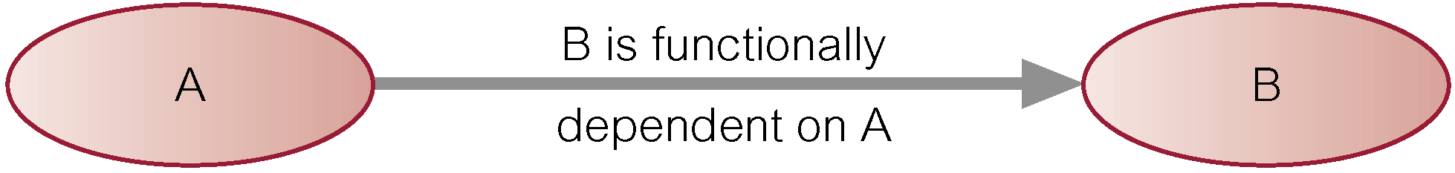
Functional Dependency
Property of the meaning (or semantics) of the attributes in a relation.
Diagrammatic representation:
Determinant of a functional dependency refers to attribute or group of attributes on left-hand side of the arrow.

Slide 13
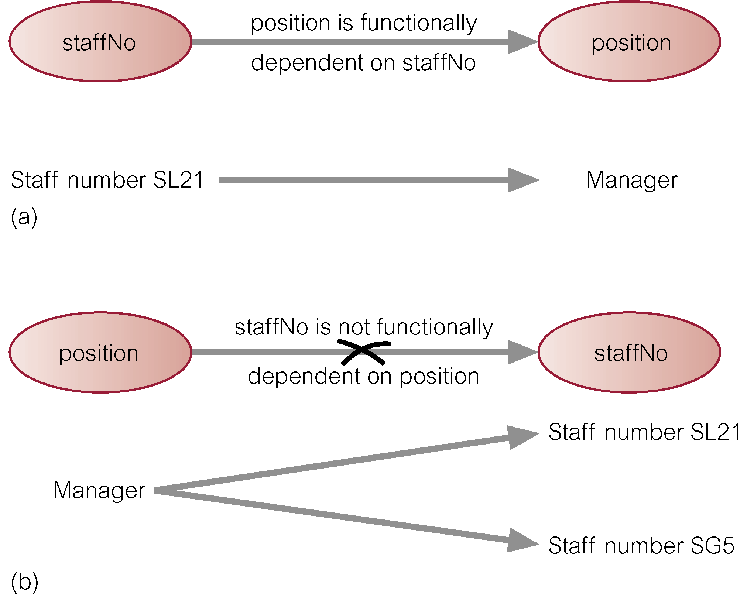
Example - Functional Dependency

Slide 14
Functional Dependency
Main characteristics of functional dependencies used in normalization:
  have a 1:1 relationship between attribute(s) on left and right-hand side of a dependency;
  hold for all time;
  are nontrivial.

Slide 15
Functional Dependency
Complete set of functional dependencies for a given relation can be very large.
Important to find an approach that can reduce set to a manageable size.
Need to identify set of functional dependencies (X) for a relation that is smaller than complete set of functional dependencies (Y) for that relation and has property that every functional dependency in Y is implied by functional dependencies in X.

Slide 16
Functional Dependency
Set of all functional dependencies implied by a given set of functional dependencies X called closure of X (written X⁺).
Set of inference rules, called Armstrong’s axioms, specifies how new functional dependencies can be inferred from given ones.

Slide 17
Functional Dependency
Let A, B, and C be subsets of the attributes of relation R. Armstrong’s axioms are as follows:
1. Reflexivity
  If B is a subset of A, then A → B
2. Augmentation
  If A → B, then A,C → B,C
3. Transitivity
  If A → B and B → C, then A → C

Slide 18
The Process of Normalization
Formal technique for analyzing a relation based on its primary key and functional dependencies between its attributes.
Often executed as a series of steps. Each step corresponds to a specific normal form, which has known properties.
As normalization proceeds, relations become progressively more restricted (stronger) in format and also less vulnerable to update anomalies.

Slide 19
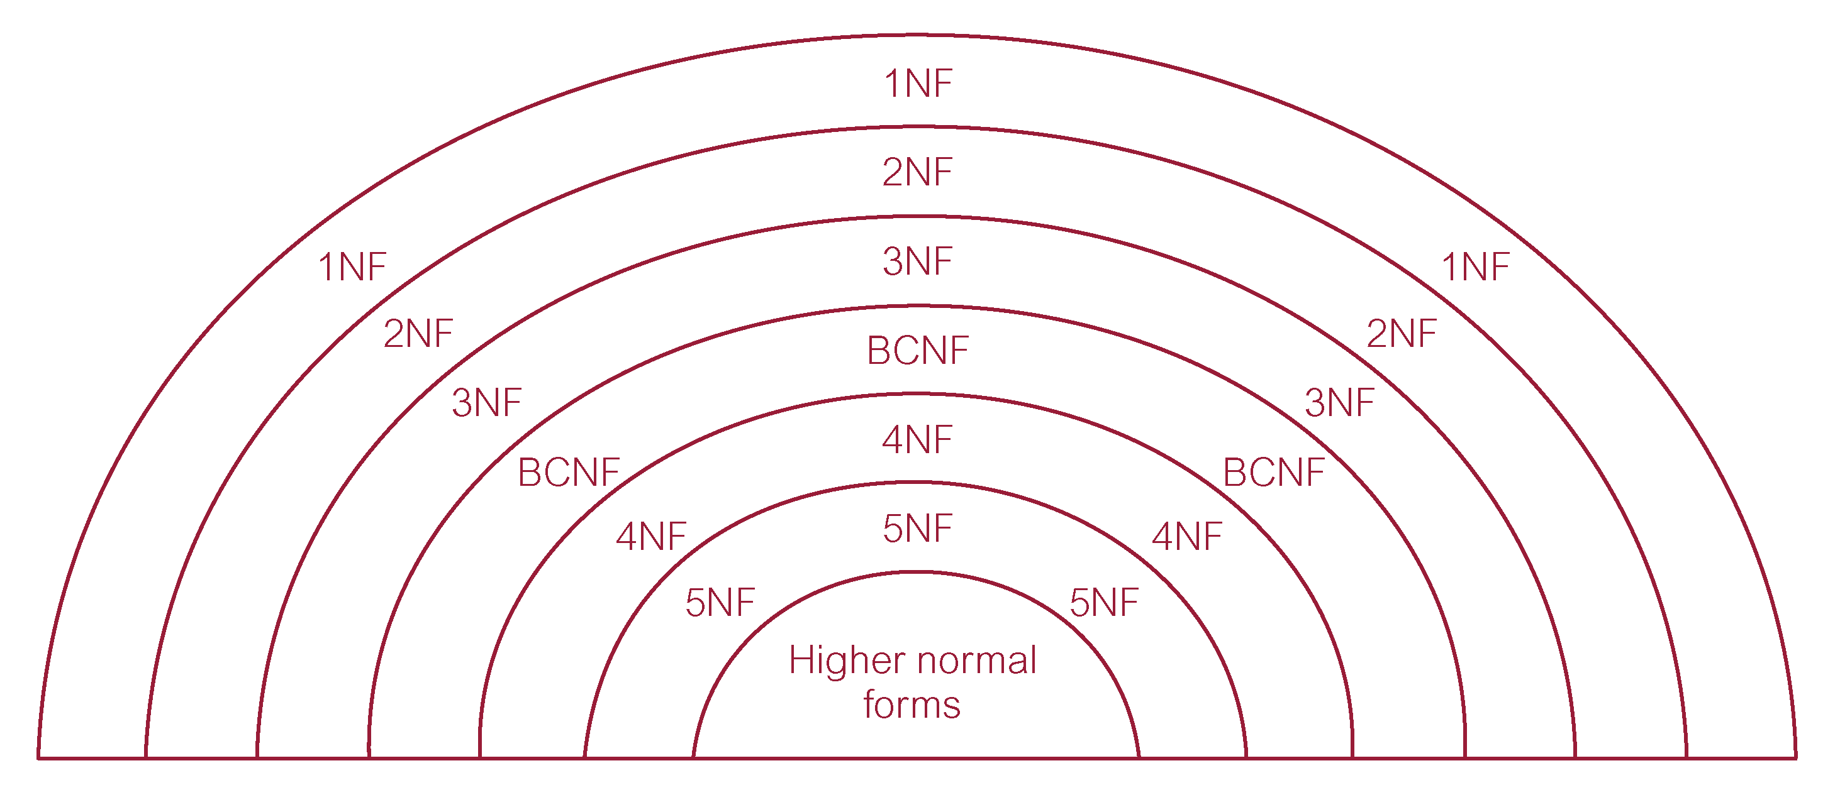
Relationship Between Normal Forms

Slide 20
Unnormalized Form (UNF)
A table that contains one or more repeating groups.
To create an unnormalized table:
  transform data from information source (e.g. form) into table format with columns and rows.

Slide 21
First Normal Form (1NF)
A relation in which intersection of each row and column contains one and only one value.

Slide 22
UNF to 1NF
Nominate an attribute or group of attributes to act as the key for the unnormalized table.
Identify repeating group(s) in unnormalized table which repeats for the key attribute(s).

Slide 23
UNF to 1NF
Remove repeating group by:
  entering appropriate data into the empty columns of rows containing repeating data (‘flattening’ the table).
Or by
  placing repeating data along with copy of the original key attribute(s) into a separate relation.

Slide 24
Second Normal Form (2NF)
Based on concept of full functional dependency:
  A and B are attributes of a relation,
  B is fully dependent on A if B is functionally dependent on A but not on any proper subset of A.
2NF - A relation that is in 1NF and every non-primary-key attribute is fully functionally dependent on the primary key.

Slide 25
1NF to 2NF
Identify primary key for the 1NF relation.
Identify functional dependencies in the relation.
If partial dependencies exist on the primary key remove them by placing them in a new relation along with copy of their determinant.

Slide 26
Third Normal Form (3NF)
Based on concept of transitive dependency:
  A, B and C are attributes of a relation such that if A → B and B → C,
  then C is transitively dependent on A through B. (Provided that A is not functionally dependent on B or C).
3NF - A relation that is in 1NF and 2NF and in which no non-primary-key attribute is transitively dependent on the primary key.

Slide 27
2NF to 3NF
Identify the primary key in the 2NF relation.
Identify functional dependencies in the relation.
If transitive dependencies exist on the primary key remove them by placing them in a new relation along with copy of their determinant.

Slide 28
General Definitions of 2NF and 3NF
Second normal form (2NF)
  A relation that is in 1NF and every non-primary-key attribute is fully functionally dependent on any candidate key.
Third normal form (3NF)
  A relation that is in 1NF and 2NF and in which no non-primary-key attribute is transitively dependent on any candidate key.

Slide 29
Boyce–Codd Normal Form (BCNF)
Based on functional dependencies that take into account all candidate keys in a relation, however BCNF also has additional constraints compared with general definition of 3NF.
BCNF - A relation is in BCNF if and only if every determinant is a candidate key.

Slide 30
Boyce–Codd normal form (BCNF)
Difference between 3NF and BCNF is that for a functional dependency A → B, 3NF allows this dependency in a relation if B is a primary-key attribute and A is not a candidate key.
Whereas, BCNF insists that for this dependency to remain in a relation, A must be a candidate key.
Every relation in BCNF is also in 3NF. However, relation in 3NF may not be in BCNF.

Slide 31
Boyce–Codd normal form (BCNF)
Violation of BCNF is quite rare.
Potential to violate BCNF may occur in a relation that:
  contains two (or more) composite candidate keys;
  the candidate keys overlap (ie. have at least one attribute in common).

Slide 32
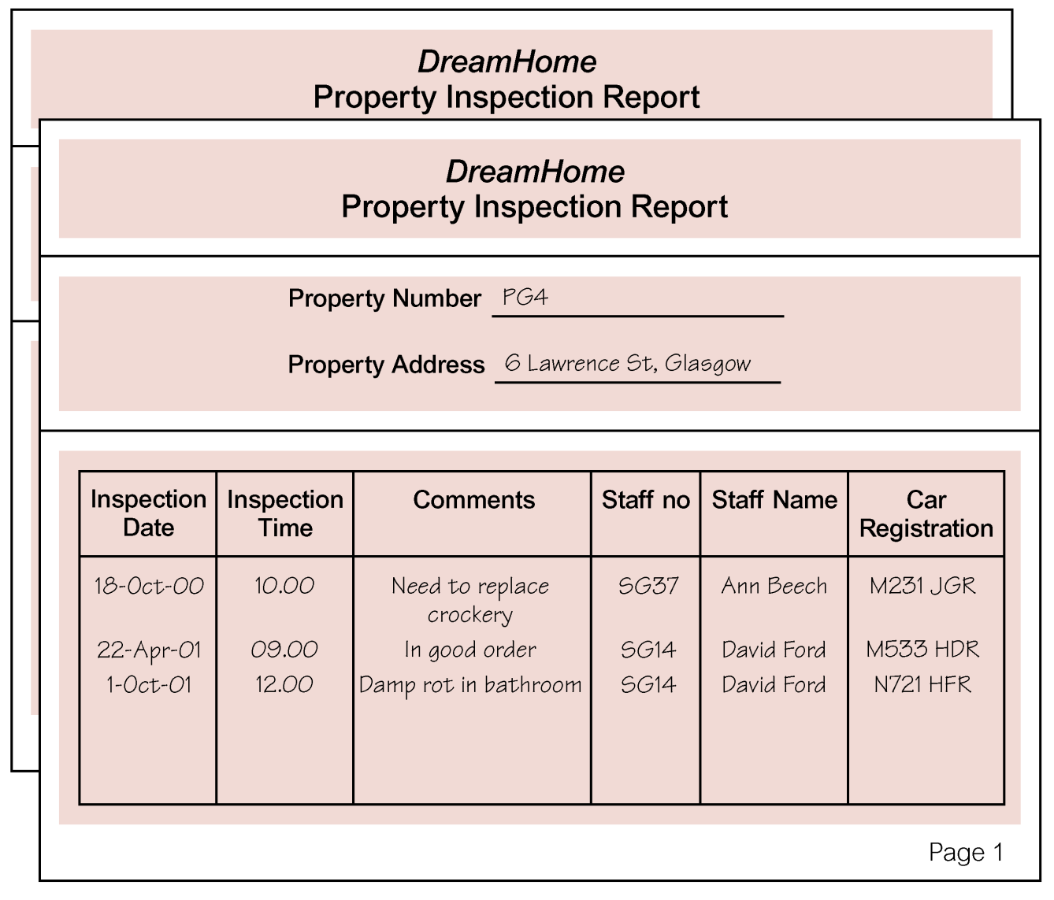
Review of Normalization (UNF to BCNF)

Slide 33
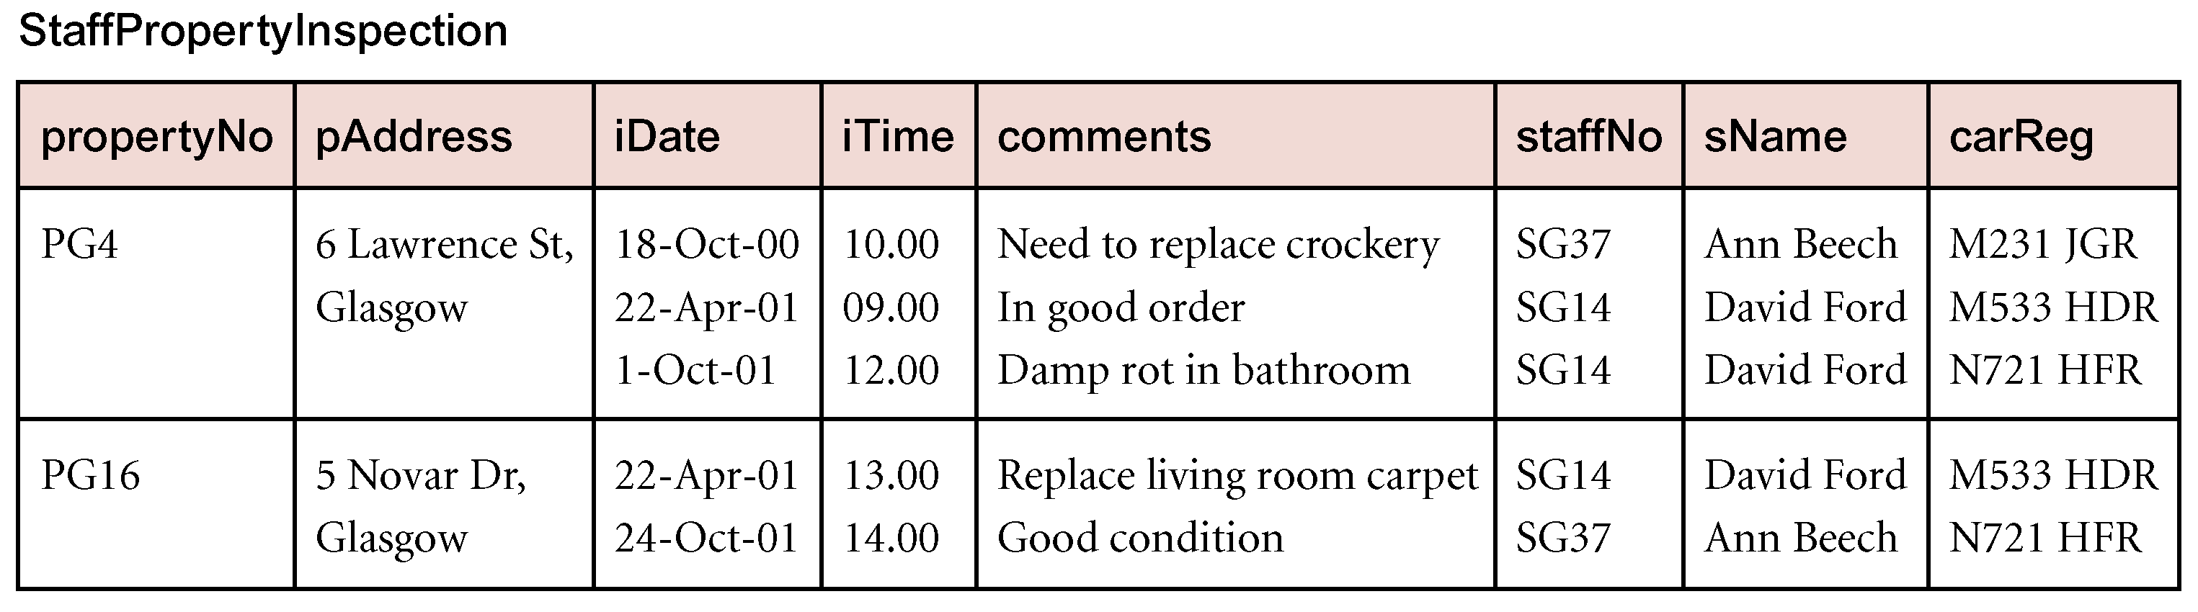
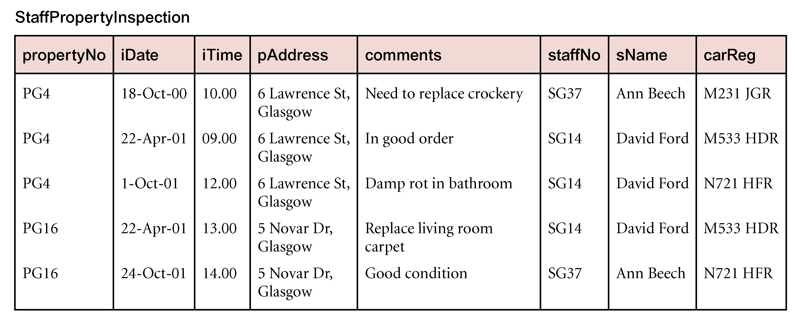
Review of Normalization (UNF to BCNF)

Slide 34
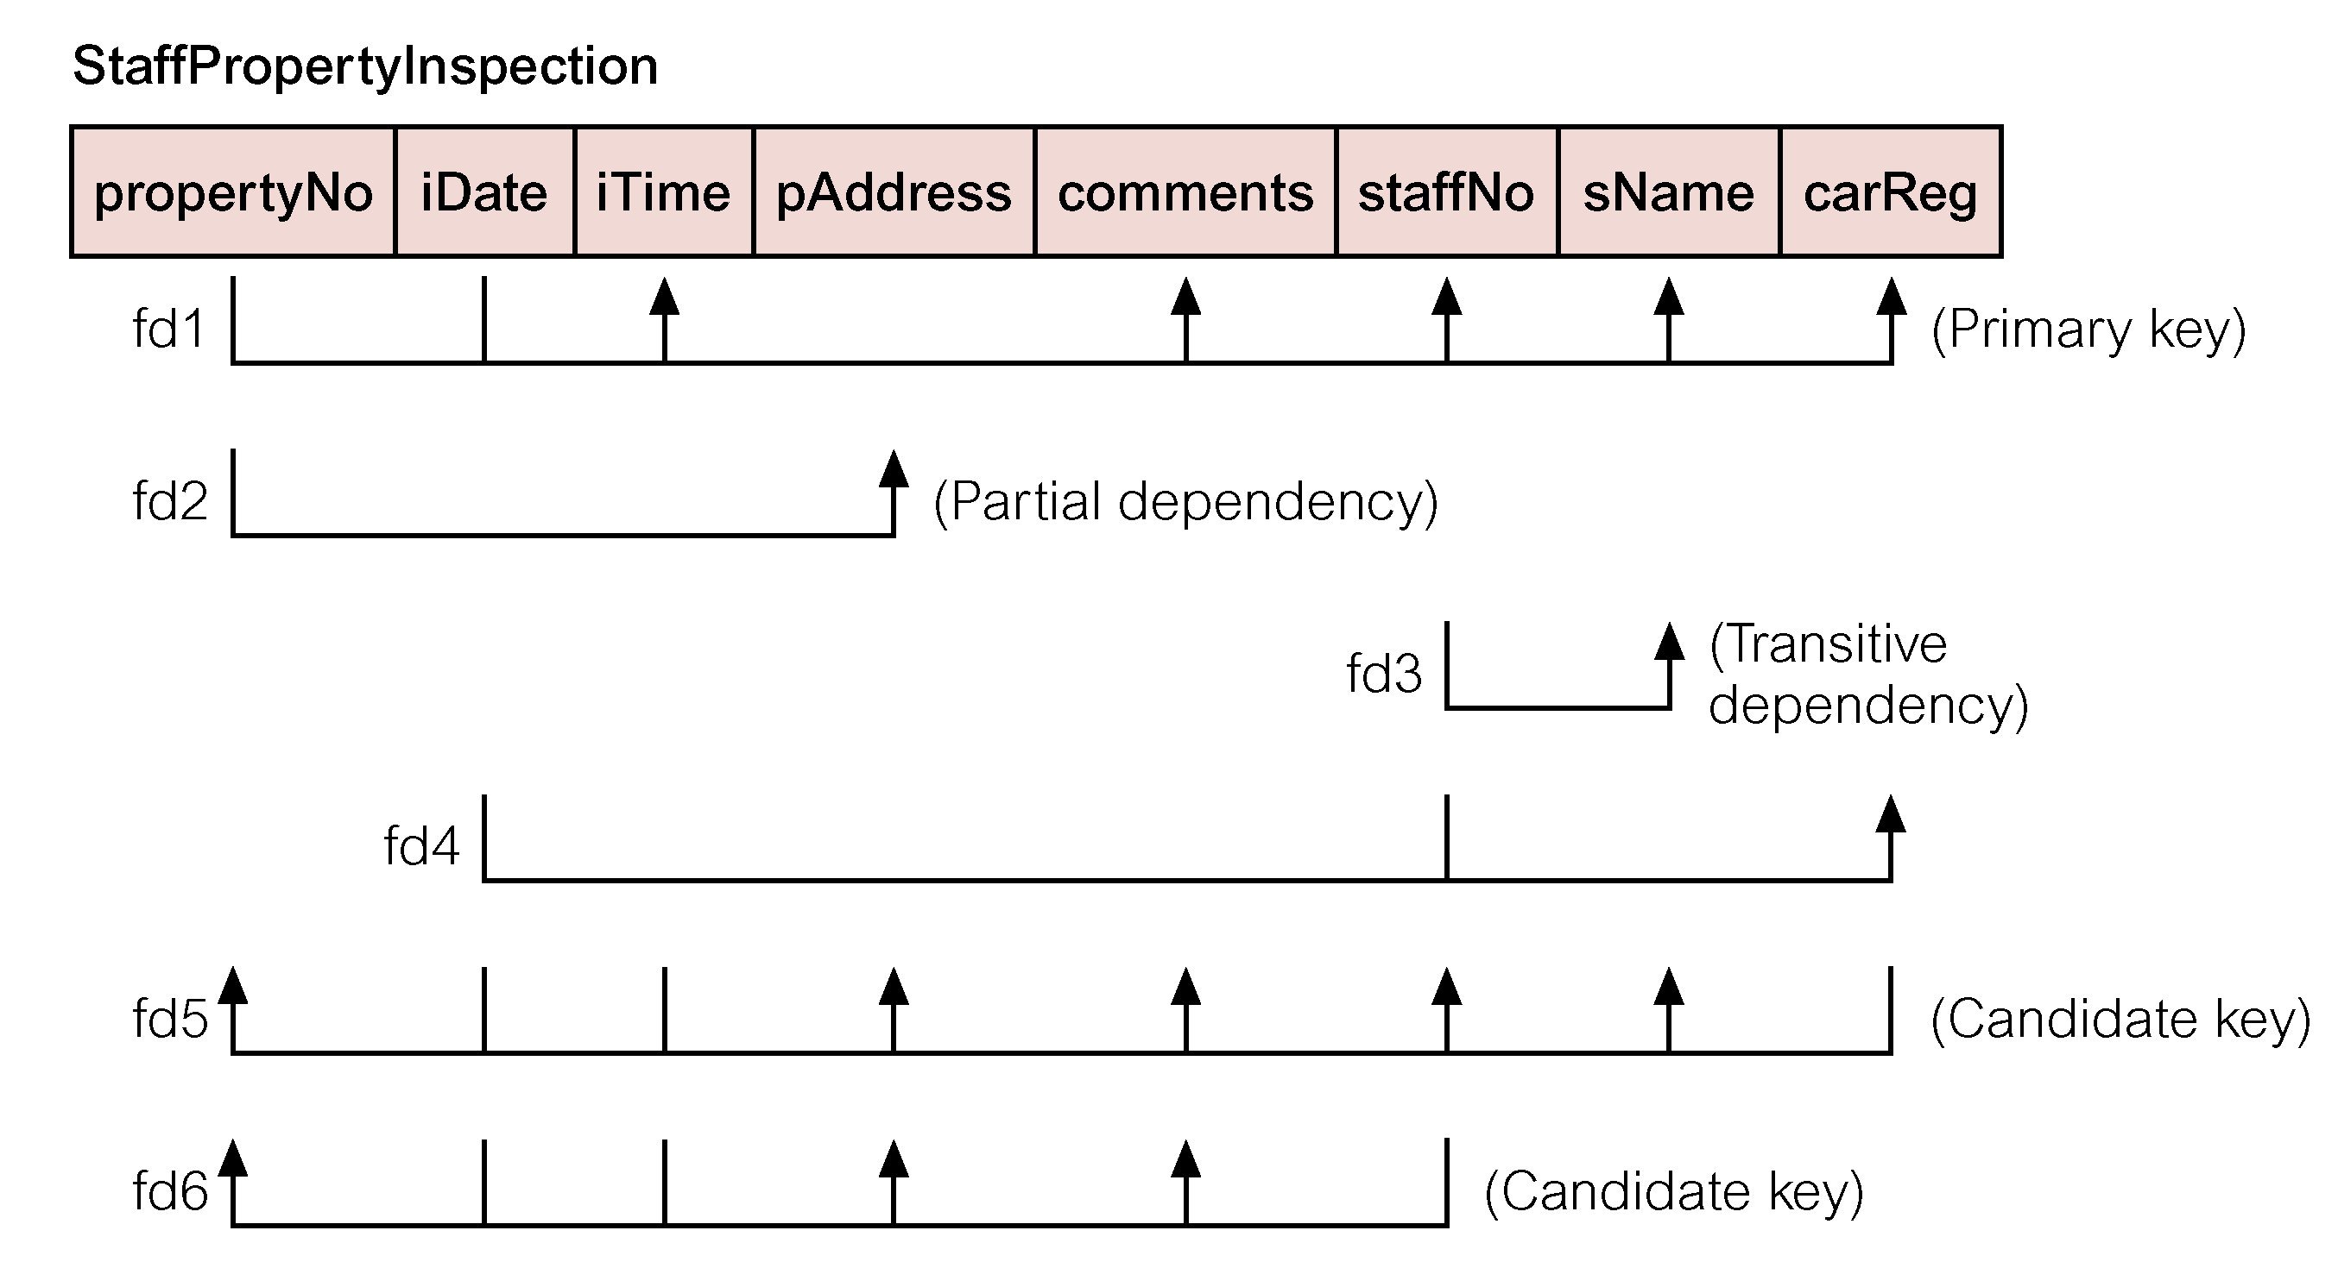
Review of Normalization (UNF to BCNF)

Slide 35
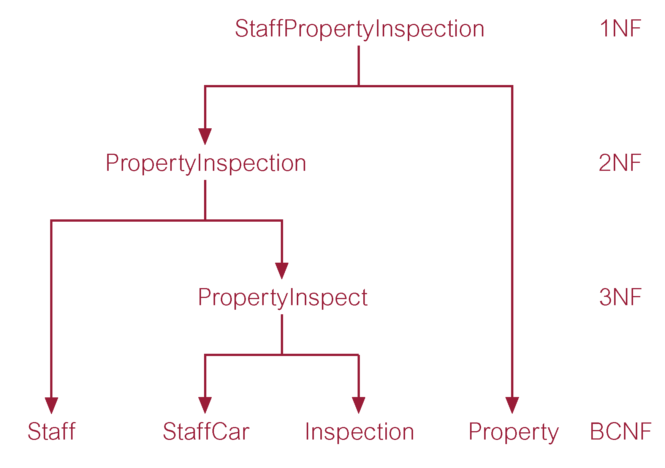
Review of Normalization (UNF to BCNF)

Slide 36
Fourth Normal Form (4NF)
Although BCNF removes anomalies due to functional dependencies, another type of dependency called a multi-valued dependency (MVD) can also cause data redundancy.
Possible existence of MVDs in a relation is due to 1NF and can result in data redundancy.

Slide 37
Fourth Normal Form (4NF) - MVD
Dependency between attributes (for example, A, B, and C) in a relation, such that for each value of A there is a set of values for B and a set of values for C. However, set of values for B and C are independent of each other.

Slide 38
Fourth Normal Form (4NF)
MVD between attributes A, B, and C in a relation using the following notation:
  A >> B
  A >> C

Slide 39
Fourth Normal Form (4NF)
MVD can be further defined as being trivial or nontrivial.
MVD A >> B in relation R is defined as being trivial if (a) B is a subset of A or (b) A ∪ B = R.
MVD is defined as being nontrivial if neither (a) nor (b) are satisfied.
Trivial MVD does not specify a constraint on a relation, while a nontrivial MVD does specify a constraint.

Slide 40
Fourth Normal Form (4NF)
Defined as a relation that is in BCNF and contains no nontrivial MVDs.

Slide 41
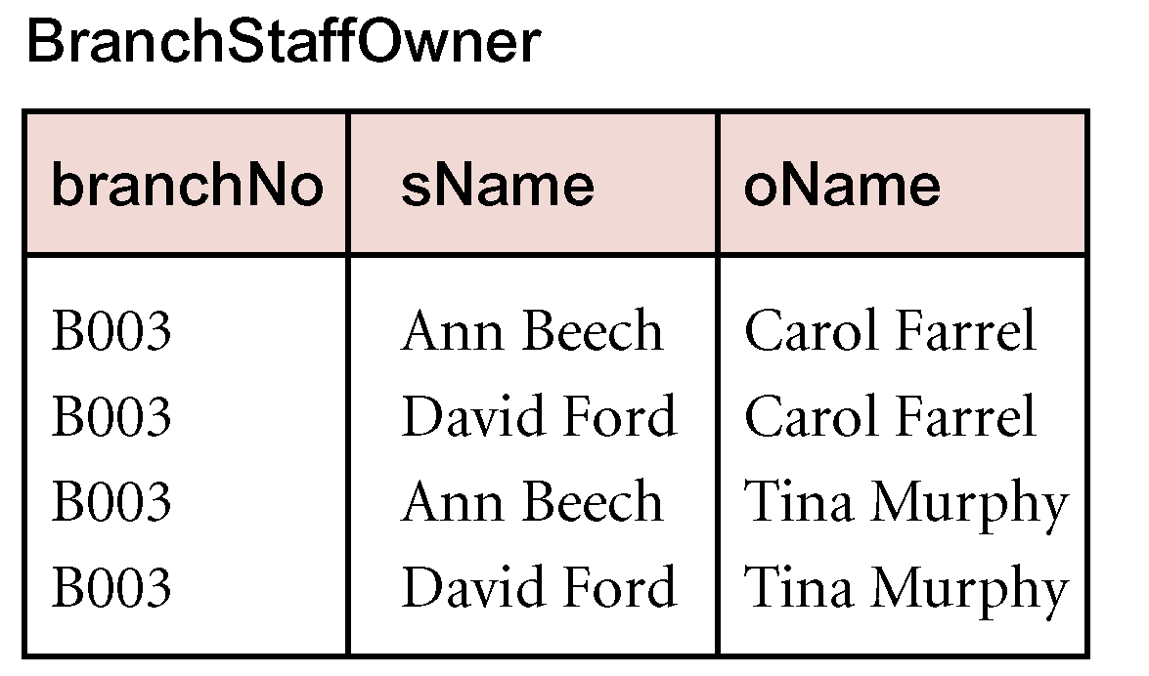
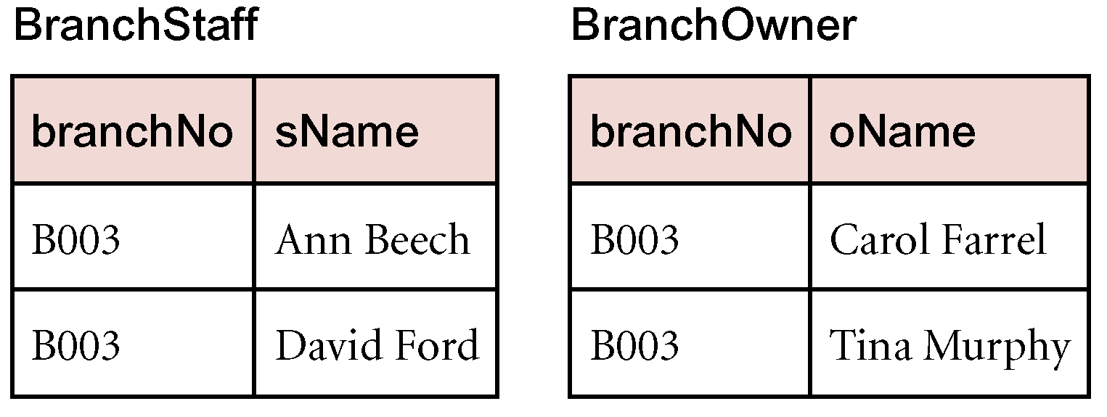
4NF - Example

Slide 42
Fifth Normal Form (5NF)
A relation decomposed into two relations must have lossless-join property, which ensures that no spurious tuples are generated when relations are reunited through a natural join.
However, there are requirements to decompose a relation into more than two relations.
Although rare, these cases are managed by join dependency and fifth normal form (5NF).

Slide 43
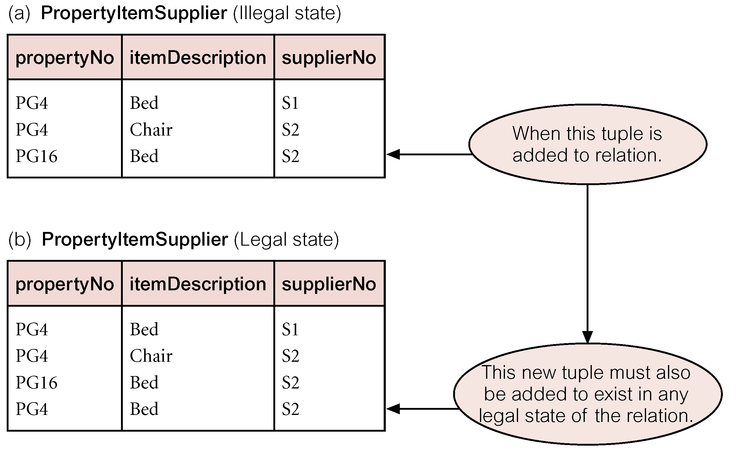
Fifth Normal Form (5NF)
A relation that has no join dependency.

Slide 44
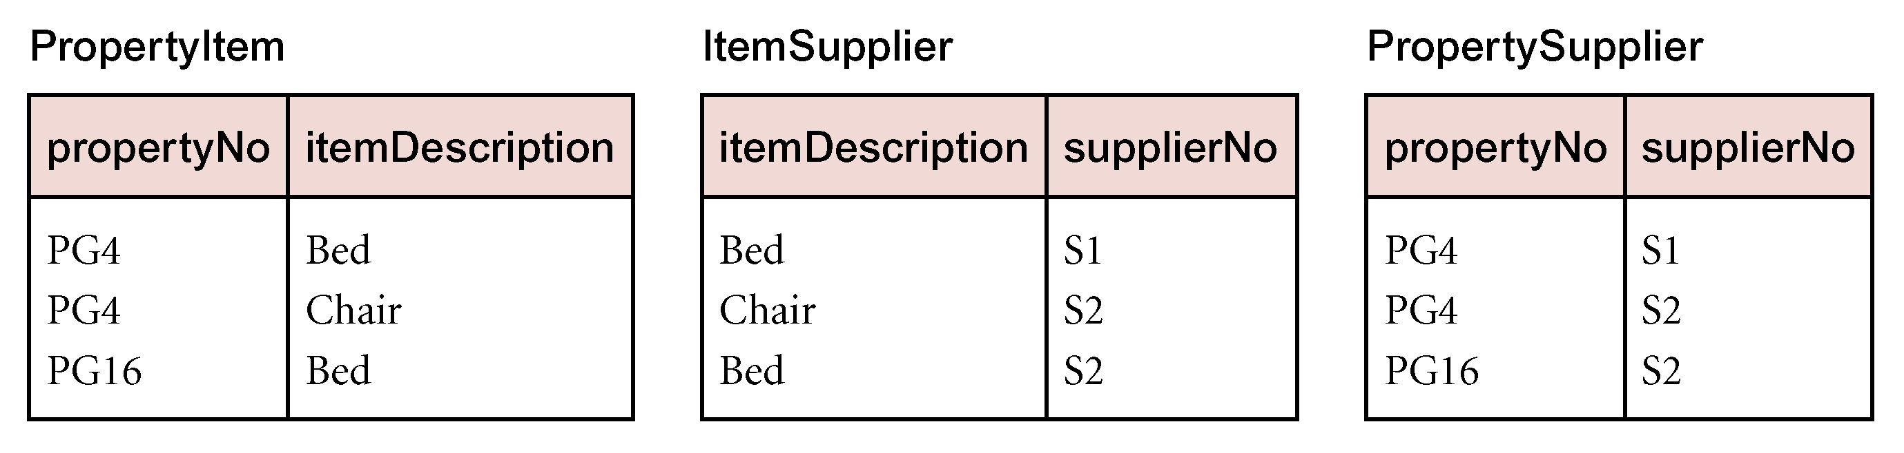
5NF - Example

